Slide 1


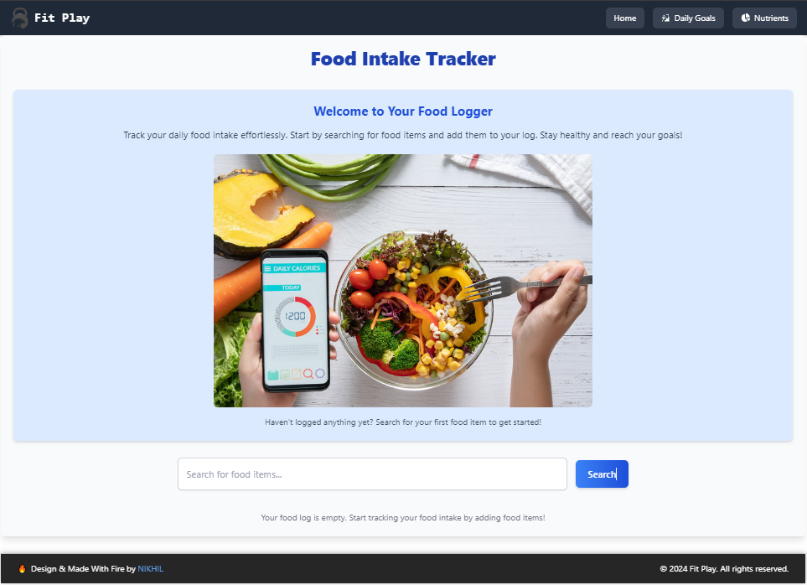
FitPlay
Application
Your Personal Nutrition Tracker
Track, Analyze, and Improve Your Daily Nutritional Intake

Slide 2
Introduction
What is FitPlay?
FitPlay is a User Friendly Application designed to help users log and track their daily food intake, providing detailed nutritional insights to promote healthier eating habits.
Many people who go to the gym or exercise regularly find it hard to manage their nutrition to reach their fitness goals. Whether they want to build muscle, lose weight, or maintain energy levels, tracking and adjusting their food intake can be difficult.
To solve this problem, FitPlay Comes.

Slide 3
So ,What Does FitPlay Do?
1. Tracks Daily Food Intake
Users can log what they eat each day.
Provides detailed nutritional information, including calories, proteins, fats, carbs, and more.
2. Personalized Nutritional Guidance
Tailors recommendations based on individual fitness goals.
Helps users understand how much they need to eat or avoid to gain muscle, lose weight, or maintain energy levels.
3. Real-Time Insights
Continuously updates users on their progress throughout the day.
4. User-Friendly Interface
5. Visual Nutrient Tracking:Displays nutrient breakdowns through charts and graphs.

Slide 4
Technical Overview
Technology Stack
Frontend: React.js
API: Integrated with Edamam for nutritional data
Data Storage: Local storage for offline access
State Management: Context API
Styling: Tailwind CSS for responsive design
Key Integrations
API for fetching food details
React-Google-Charts for visualizing nutrition data

Slide 5
Nutrient Tracking
Visual Representation
Explanation of how the app displays nutrient breakdown.
Charts/graphs showing macronutrient and micronutrient intake.
Customization
Option for users to set daily nutritional goals.

Slide 6
User InterFaces
Different User Interfaces According to Device Screens.

Slide 7
DeskTop View

Slide 8
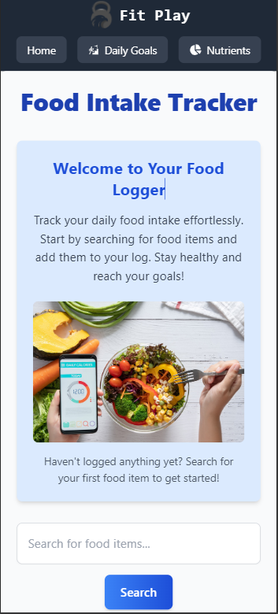
Mobile View

Slide 9
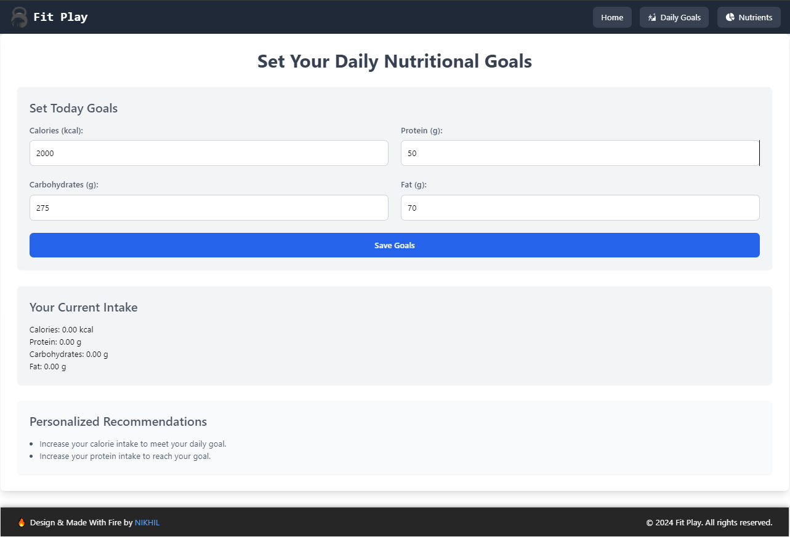

Slide 10
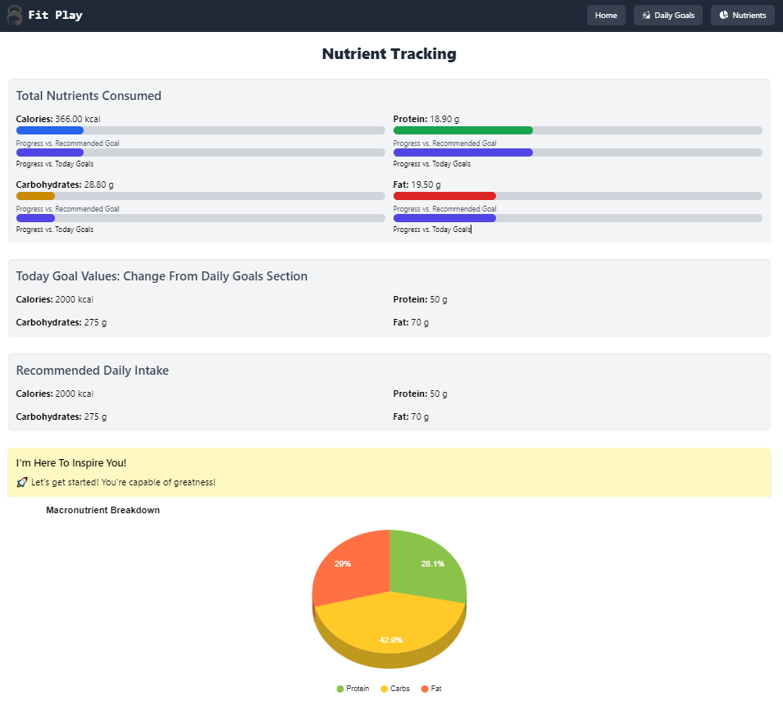
Component Detail

Slide 11
Conclusion
FitPlay provides a comprehensive solution for tracking and improving daily nutrition.
Encourages healthier eating habits through data-driven insights.

Slide 12
Questions?

Slide 13
References
Edamam API
React.js Documentation
Tailwind CSS
React-Google-Charts

Slide 14
Thank You

